Slide 1
Course Material, Notes, Videos & More
Important NIOS Updates
Secondary
Admissions
TMA
English
Maths
Science
Social Science
Painting
Public Exam
Results
Data Entry Operations
Home Science
Economics
Fees Related
Study Material
Business Studies
Senior Secondary
General Frequently Asked Questions
English
Maths
Physics
Chemistry
Biology
Latest Announcements
Data Entry Operations
Computer Science
Painting
Economics
Home Science
Political Science
Business Studies

Slide 2
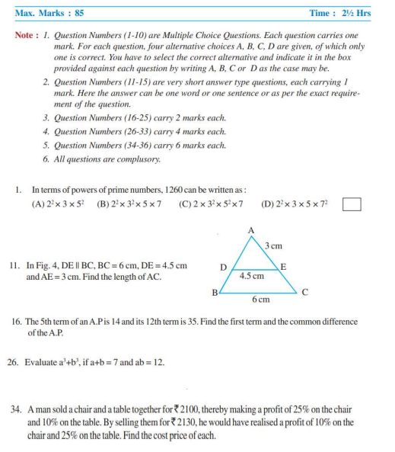
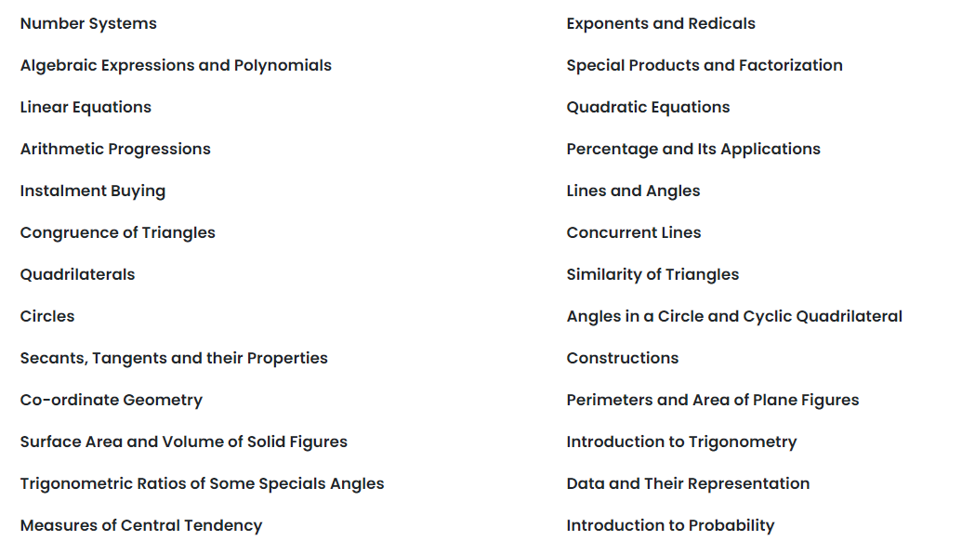
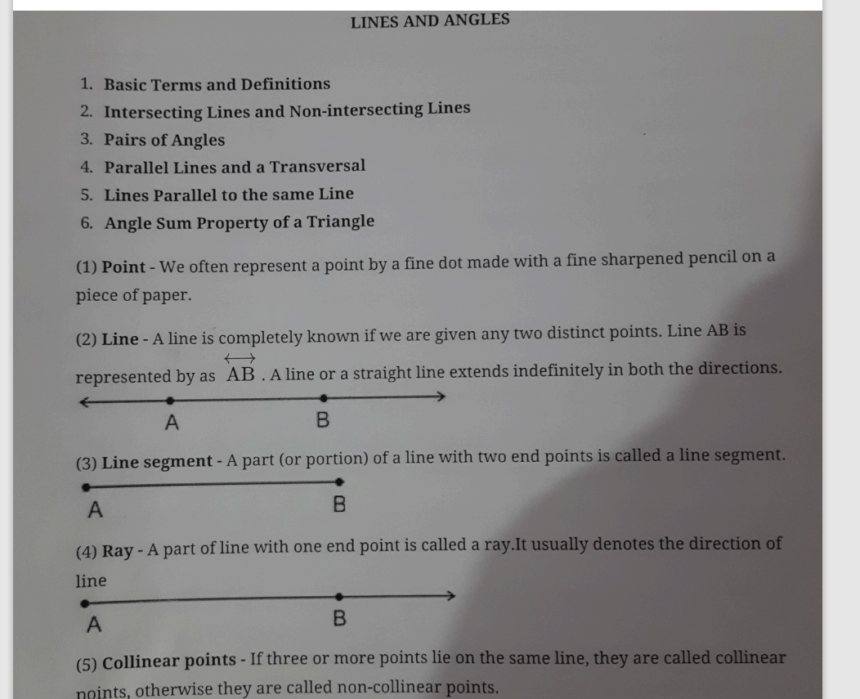
Mathematics X
Topics Covered
Sample Notes
Sample Questions
Demo Videos

Slide 3
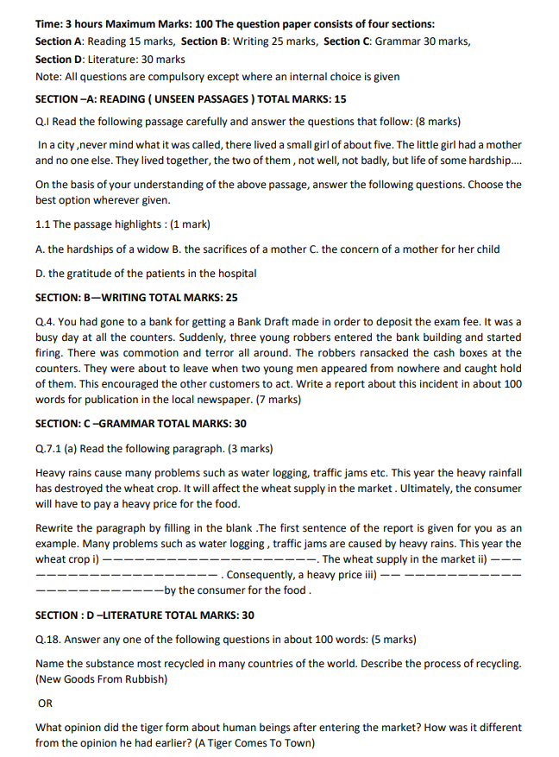
English X
Topics Covered
Sample Notes
Sample Questions
Demo Videos

Slide 4
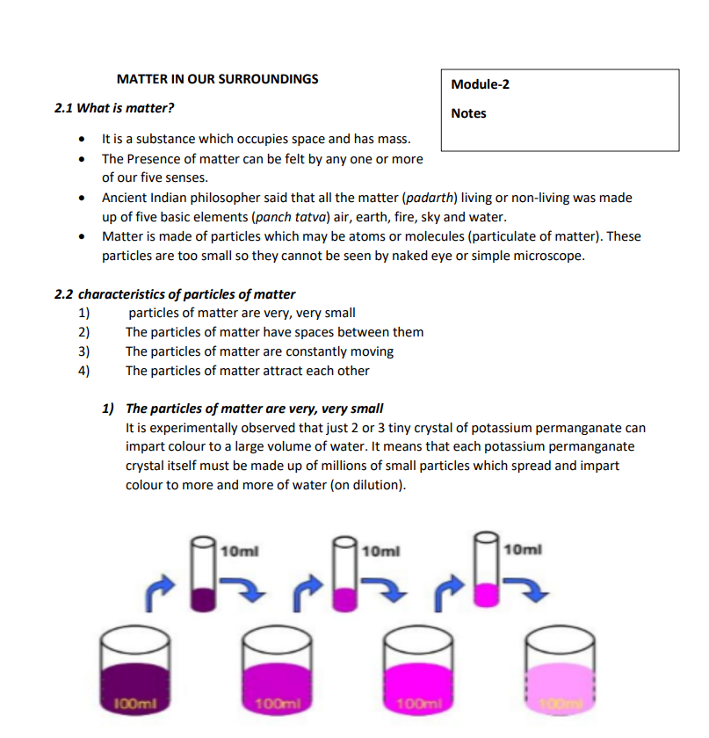
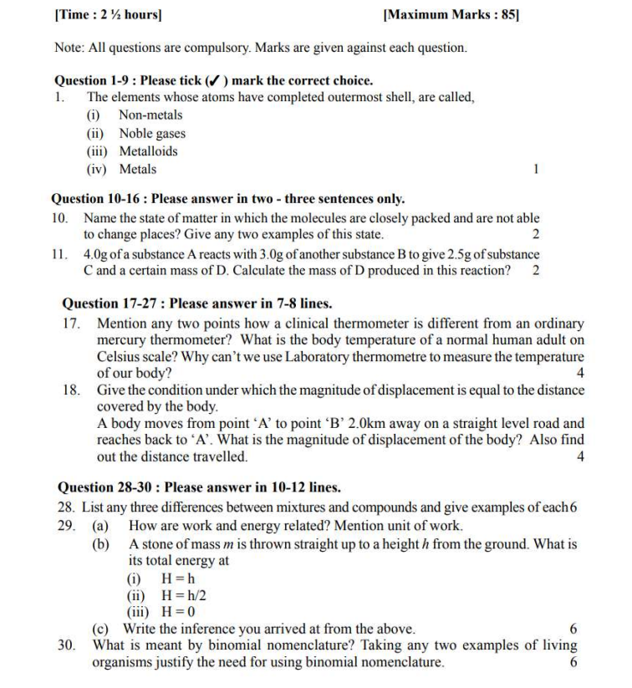
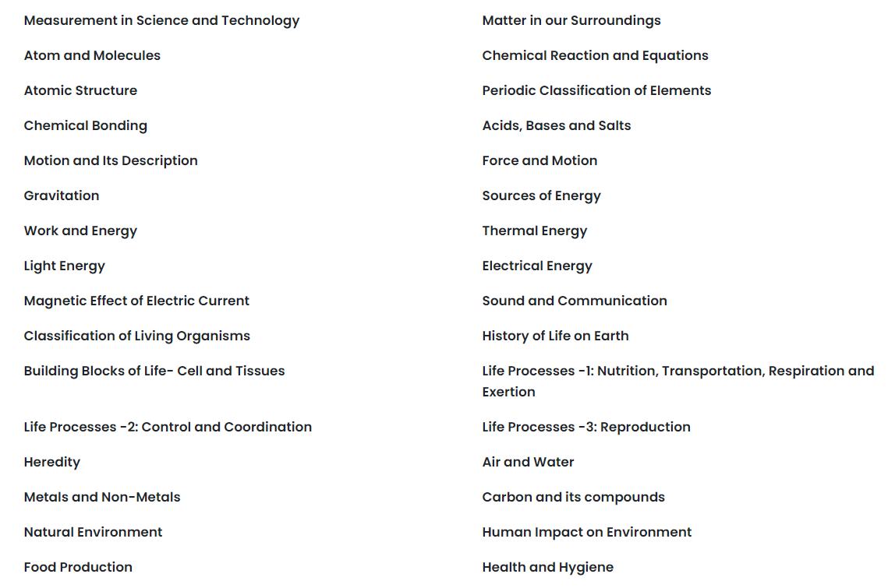
Science
Topics Covered
Sample Notes
Sample Questions
Demo Videos

Slide 5
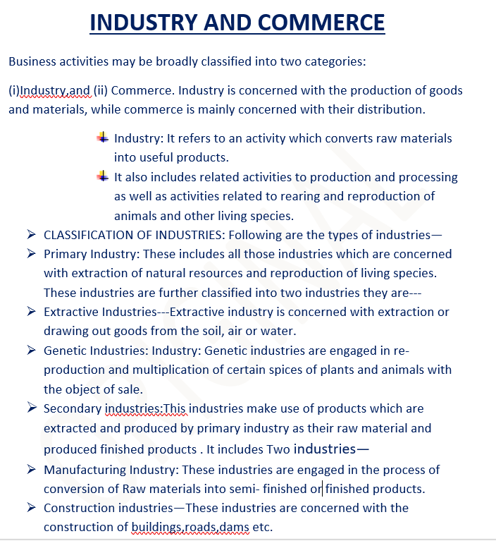
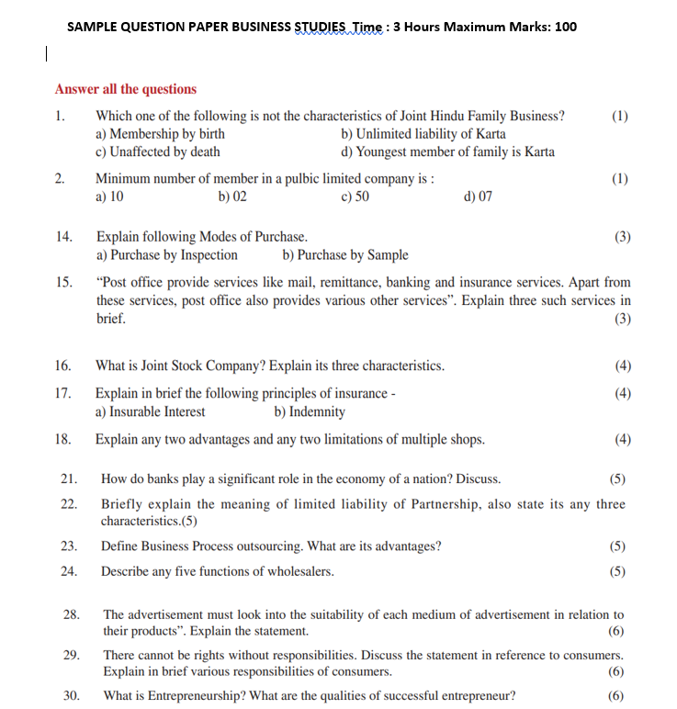
Business Studies
Topics Covered
Sample Notes
Sample Questions
Demo Videos

Slide 6
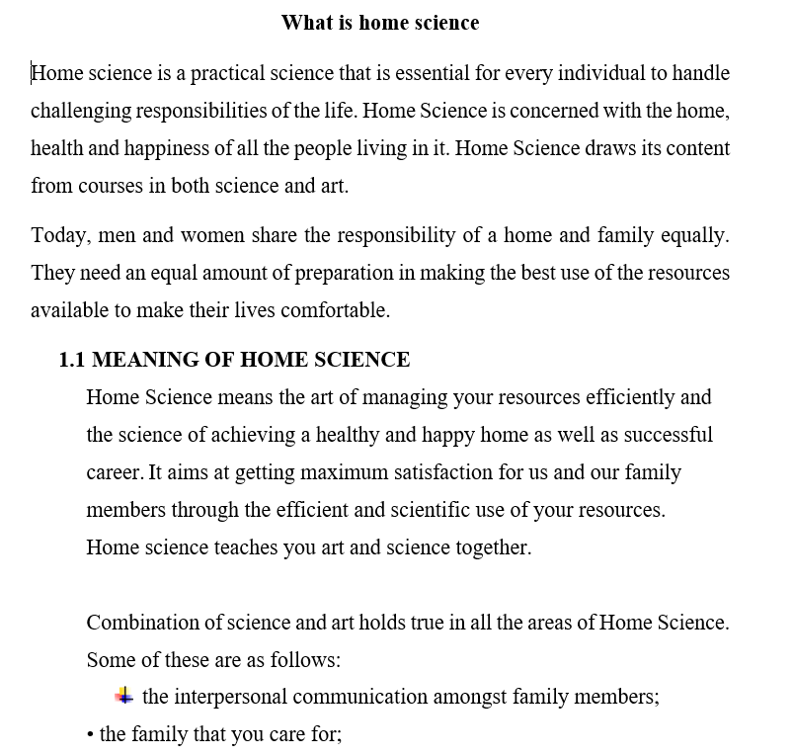
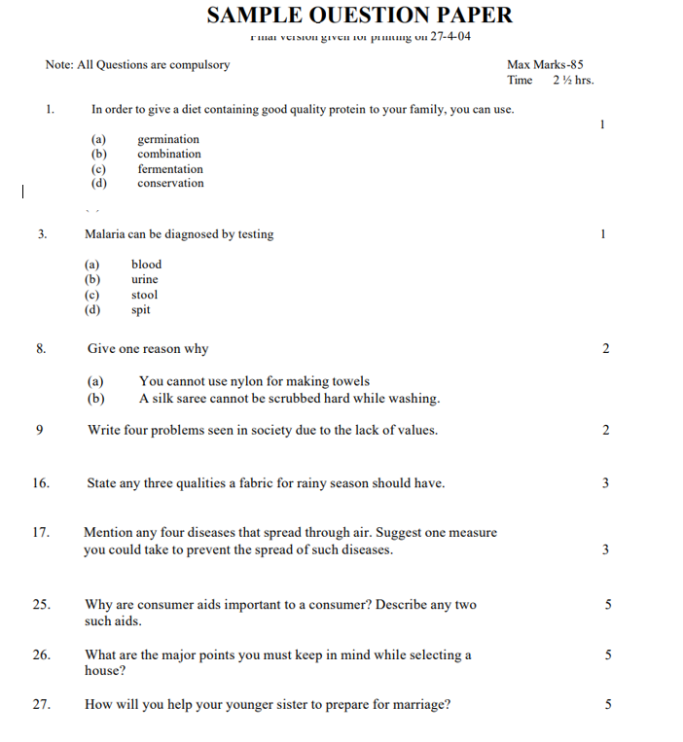
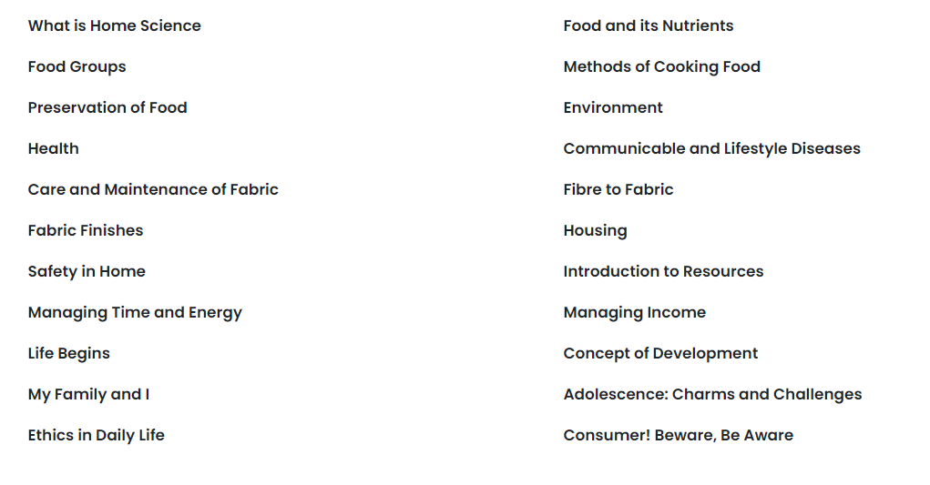
Home Science
Topics Covered
Sample Notes
Sample Questions
Demo Videos

Slide 7
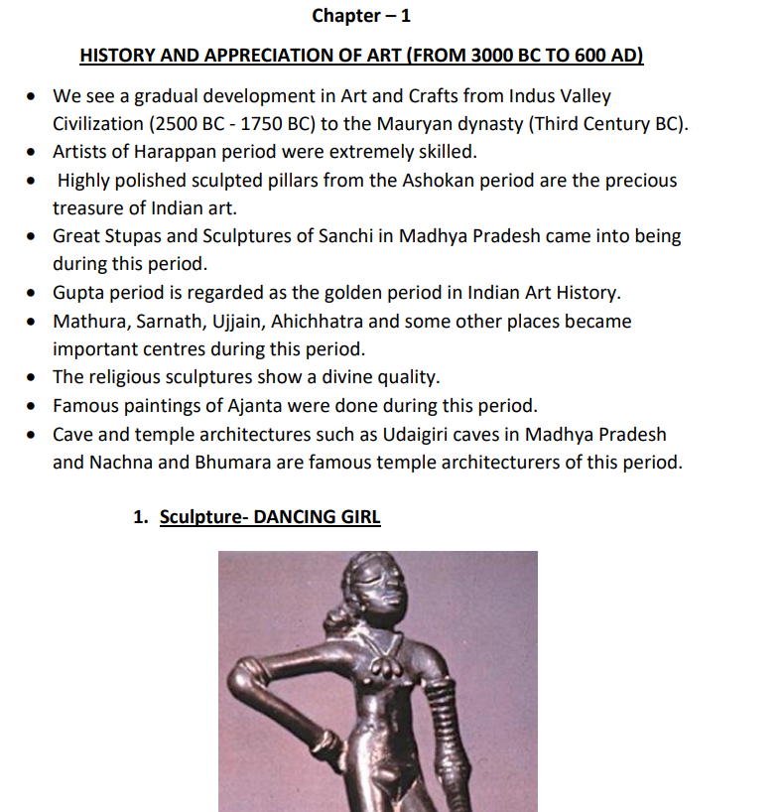
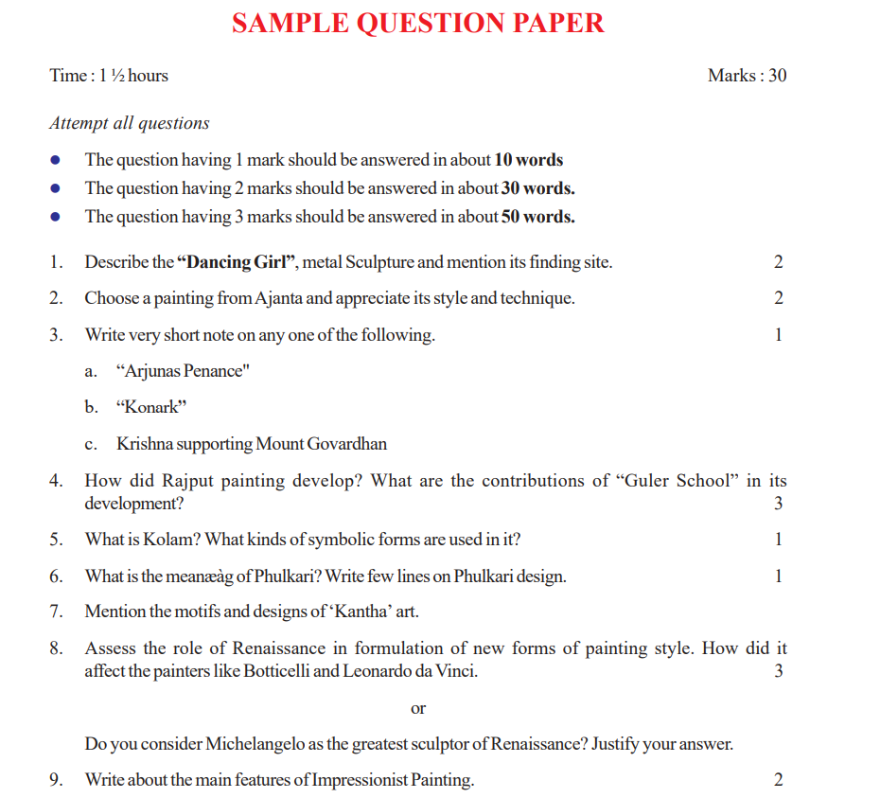
Painting
Topics Covered
Sample Notes
Sample Questions
Demo Videos

Slide 8
Data Entry Operations
Topics Covered
Sample Notes
Sample Questions
Demo Videos

Slide 9
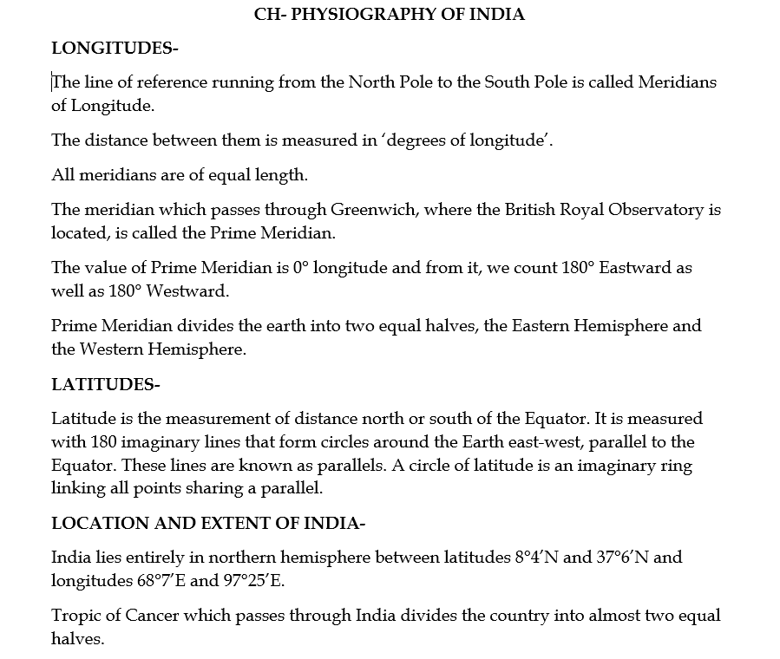
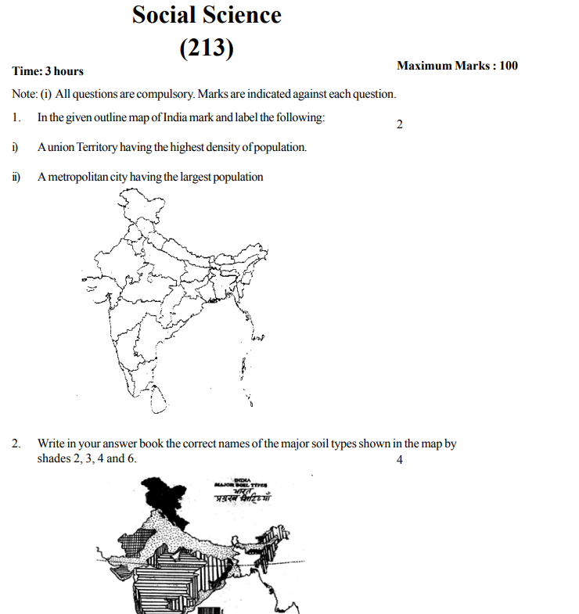
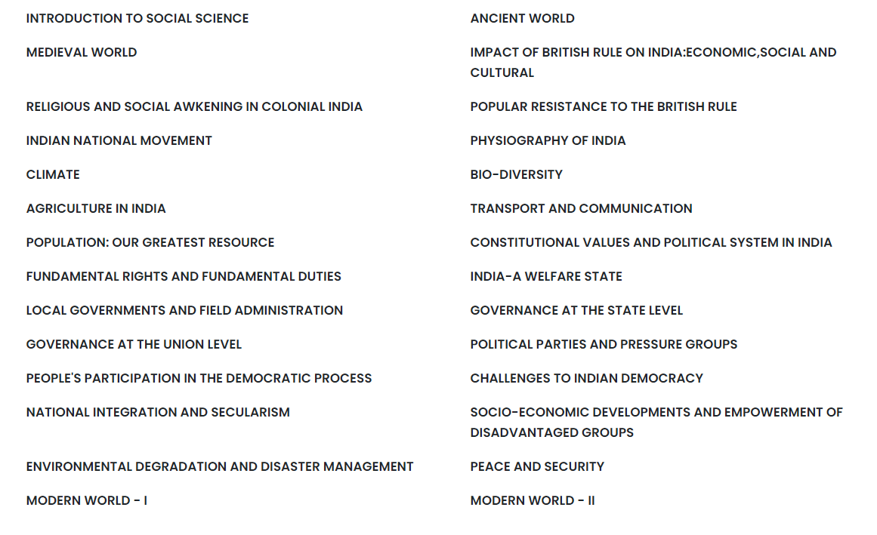
Social Science
Topics Covered
Sample Notes
Sample Questions
Demo Videos

Slide 10
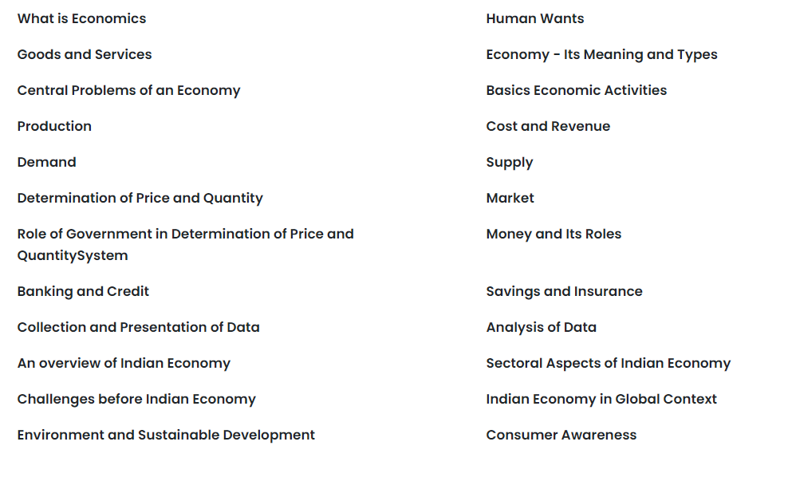
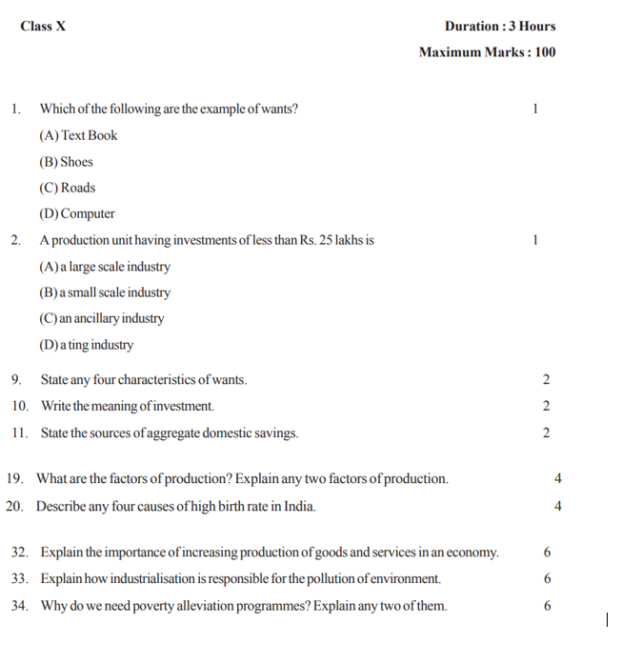
Economics
Topics Covered
Sample Notes
Sample Questions
Demo Videos

